Slide 1

Implementation of DNS, DHCP and FTP
Computer Networks (CN)
DU #2301CS501
Prof. Maulik D Trivedi
Computer Engineering
maulik.trivedi@darshan.ac.in
+91-9998265805
Disclaimer: The images used in this presentation are sourced solely for educational and nonprofit purposes. The author of this presentation asserts no ownership or copyright claims over them."

Slide 2
✓
Outline
What is DNS?
How DNS works?
Implementation of DNS in CPT
What is DHCP?
Implementation of DHCP in CPT
What is FTP?
Implementation of FTP in CPT

Slide 3
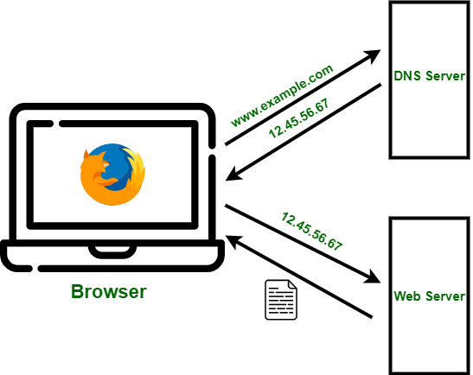
DNS (Domain Name system)
The Domain Name System (DNS) is the phonebook of the Internet.
Humans access information online through domain names, like nytimes.com or espn.com.
Web browsers interact through Internet Protocol (IP) addresses. DNS translates domain names to IP addresses so browsers can load Internet resources.

Slide 4
DNS (Domain Name system)
TLD server
.org
TLD server
.edu
Authoritative server
example.com
Authoritative server
Authoritative server
TLD server
.com
Root Server

Slide 5
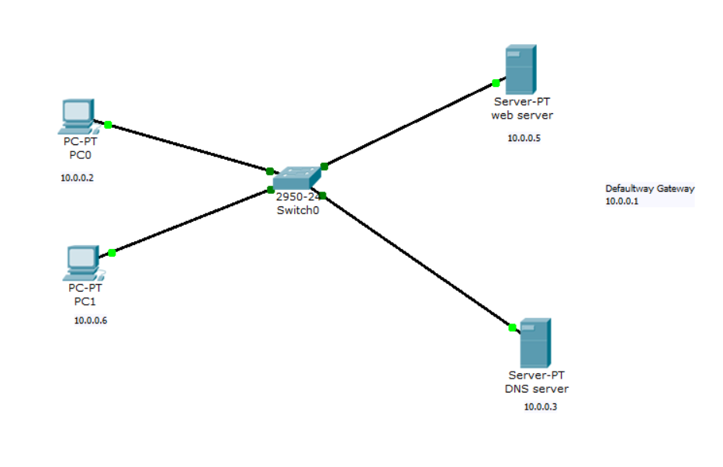
DNS in CPT
Design the DNS server using Cisco Packet Tracer
Step 1: Create network as shown in figure.

Slide 6
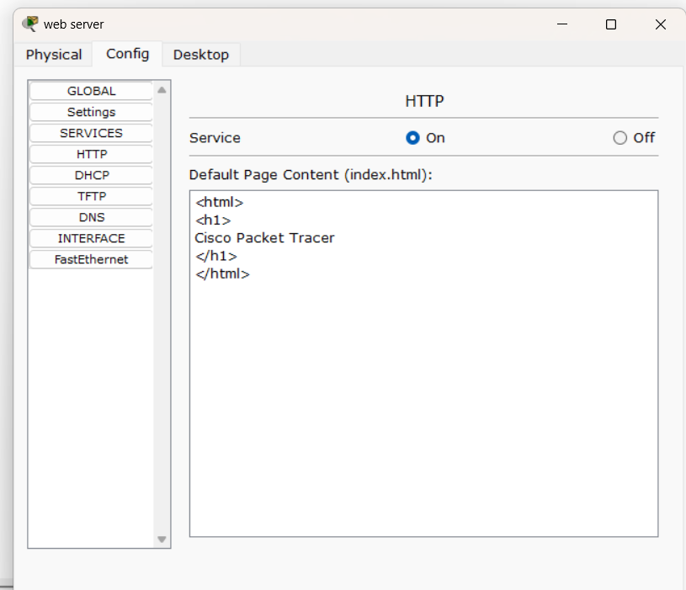
DNS in CPT
Step 2: Apply IP configuration to PCs
Step 3: Apply IP configuration to Web Server
Step 4: Go to the config menu of the server and
go to services-> HTTP
Step 5: In the web server go to index.html
design html page

Slide 7
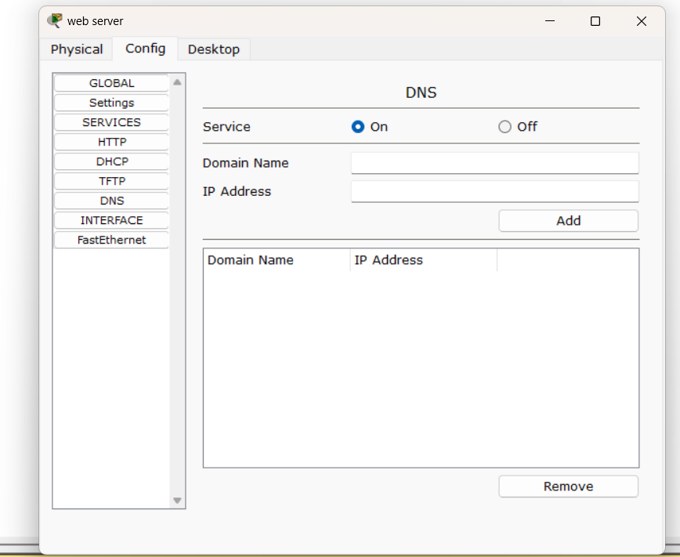
DNS in CPT
Step 6: Apply IP configuration to DNS Server
Step 7: Go to the config menu of the server and go to services-> DNS
Step 5: Apply Domain Name and IP address and add them
Step 6: Now go to PCs and open web browser to open the website using domain name

Slide 8
DHCP (Dynamic Host Configuration Protocol)
DHCP stands for Dynamic Host Configuration Protocol.
DHCP helps enterprises to smoothly manage the allocation of IP addresses to the end-user clients’ devices such as desktops, laptops
DHCP helps in managing the entire process automatically and centrally. DHCP helps maintain a unique IP address for a host using the server.

Slide 9
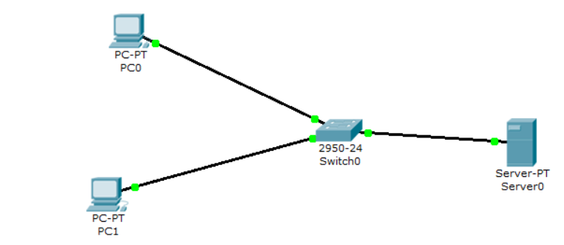
DHCP in CPT
Design the DHCP server using Cisco Packet Tracer
Step 1: Create network as shown in figure.

Slide 10
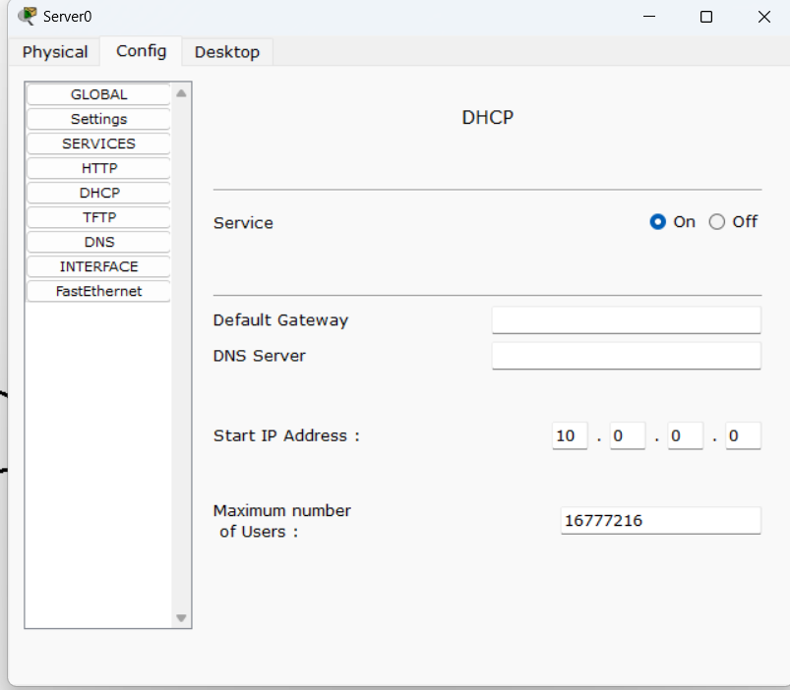
DHCP in CPT
Step 2: Apply IP configuration to PCs
Step 3: Apply IP configuration to DHCP Server
Step 4: Go to the config menu of the server and go to services-> DHCP
Step 5: Apply default gateway, start IP address, and maximum number of users
Step 6: Give gateway address to PCs
Step 7: select DHCP in the config menu of all PCs

Slide 11
FTP in CPT
Design the DHCP server using Cisco Packet Tracer
Step 1: Create network as shown in figure.

Slide 12
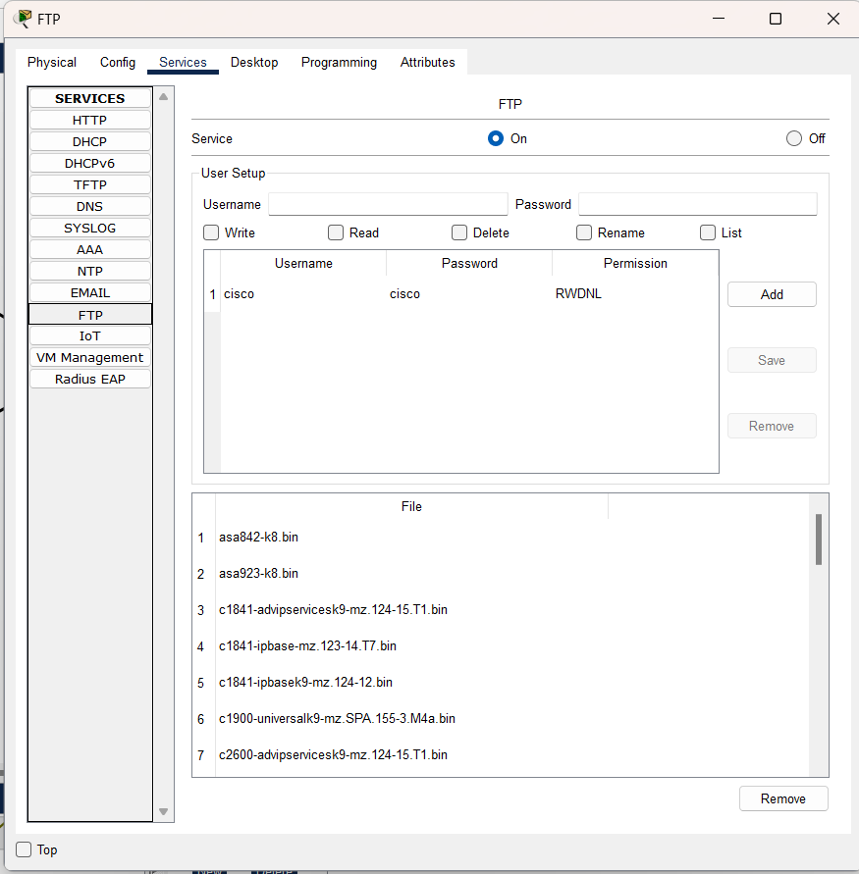
FTP in CPT
Step 2: Apply IP configuration to PCs
Step 3: Apply IP configuration to FTP Server
Step 4: Go to the config menu of the server and go to services-> FTP
Step 5: Set the username and password for the FTP server.
Step 6: Give all the access like write, read, delete, rename, and list
Step 7: Give gateway address to PCs

Slide 13
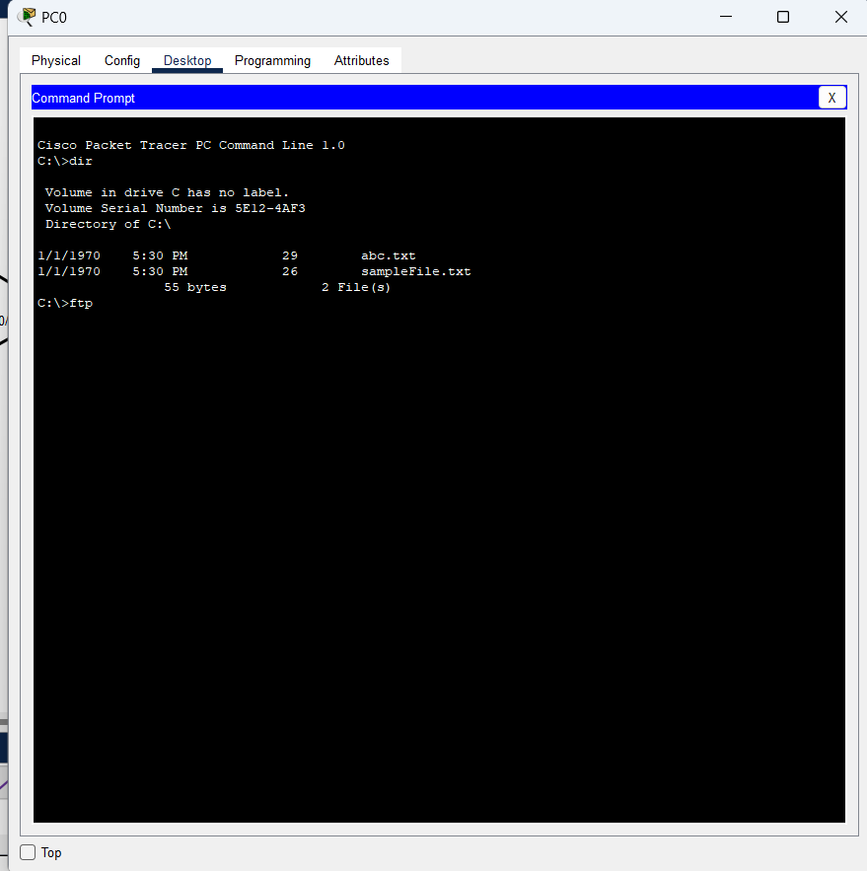
FTP in CPT – Cont.
Step 8: Go to PCs, create and save the text file.
Step 9: Check text file is shown in the directory.
Step 10: Insert .txt file in the FTP server. And delete the file from FTP.
Commands: ftp IP address of server
insert file in server command: put
Delete file in server command: delete

Slide 14
Thank you

